Slide 1
ATAI
Advanced Techniqueof Artificial Intelligence
ATAI
ChongqingUniversity _{AdvancedTechniqueof}
of Technology Artificial Intelligence
Chongqing University of
Technology
Chongqing University ^{ATAI}
_{of Technology} Advanced Techniqueof
Artificial Intelligence
Chongqing University of Technology
Chongqing University of Technology
Proxy-based Item Representation for Attribute and
Context-aware Recommendation
Code: https://github.com/theeluwin/ProxyRCA
2024.3.17 •ChongQing
—— WSDM 2024
Reported by Ling Tan
1

Slide 2
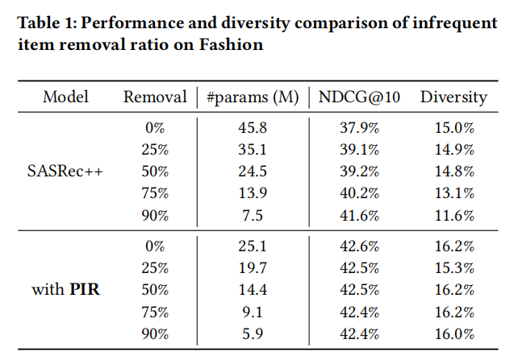
ATAI
AdvancedTechniqueof
Artificial Intelligence
ATAI
ChongqingUniversity _{AdvancedTechniqueof}
of Technology Artificial Intelligence
ChongqingUniversity of Technology
Motivation
（1） Firstly, the item frequency in recommendation
datasets follows a long-tail distribution. The item embedding matrix, which is unaware of such data distribution, cannot accurately reflect the proper training signals for the infrequent items, leading to degraded recommendation performance .
（2）Secondly, the number of items may increase indefinitely. For a real-world recommendation scenario, a large set of new items is consistently added to the system and the item embedding matrix, where most of the model parameters are stored, must scale up accordingly to accommodate them.

Slide 3
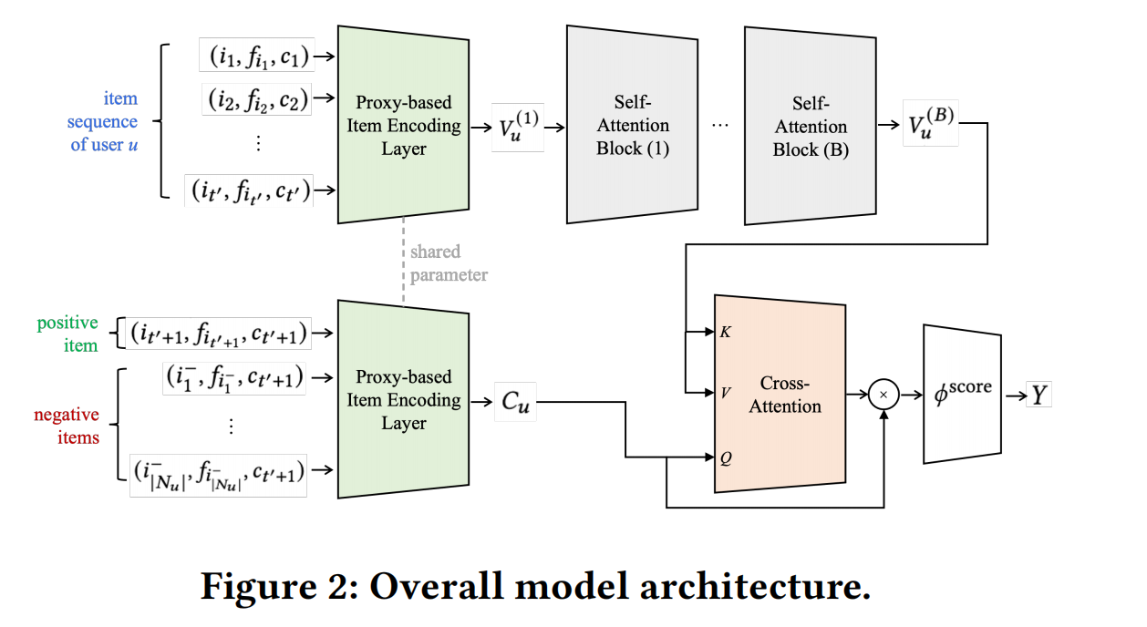
ChongqingUniversity of Technology
ATAI
AdvancedTechniqueof
Artificial Intelligence
ATAI
ChongqingUniversity _{AdvancedTechniqueof}
of Technology Artificial Intelligence
Overview

Slide 4
ChongqingUniversity of Technology
ATAI
AdvancedTechniqueof
Artificial Intelligence
ATAI
ChongqingUniversity _{AdvancedTechniqueof}
of Technology Artificial Intelligence
Overview

Slide 5
ChongqingUniversity of Technology
ATAI
AdvancedTechniqueof
Artificial Intelligence
ATAI
ChongqingUniversity _{AdvancedTechniqueof}
of Technology Artificial Intelligence
Method

Slide 6
ChongqingUniversity of Technology
ATAI
AdvancedTechniqueof
Artificial Intelligence
ATAI
ChongqingUniversity _{AdvancedTechniqueof}
of Technology Artificial Intelligence
Method

Slide 7
ATAI
AdvancedTechniqueof
Artificial Intelligence
ATAI
ChongqingUniversity _{AdvancedTechniqueof}
of Technology Artificial Intelligence
ChongqingUniversity of Technology
Experiments

Slide 8
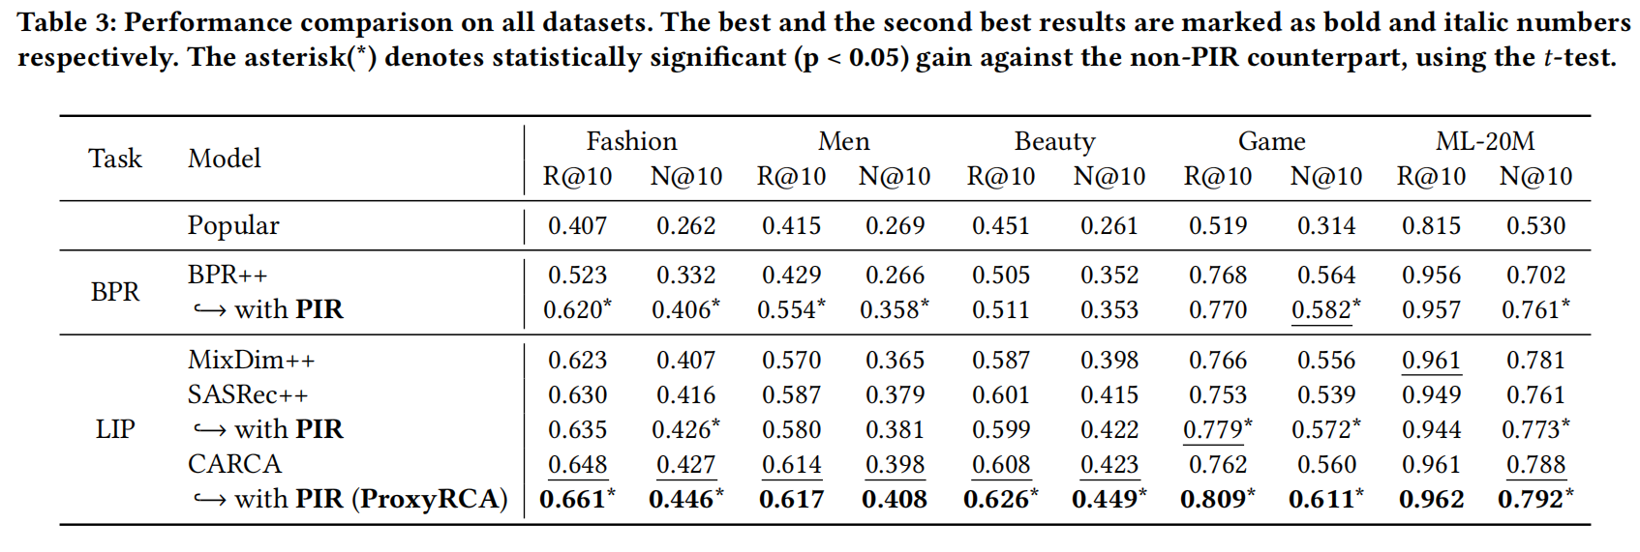
ATAI
AdvancedTechniqueof
Artificial Intelligence
ATAI
ChongqingUniversity _{AdvancedTechniqueof}
of Technology Artificial Intelligence
ChongqingUniversity of Technology
Experiments

Slide 9
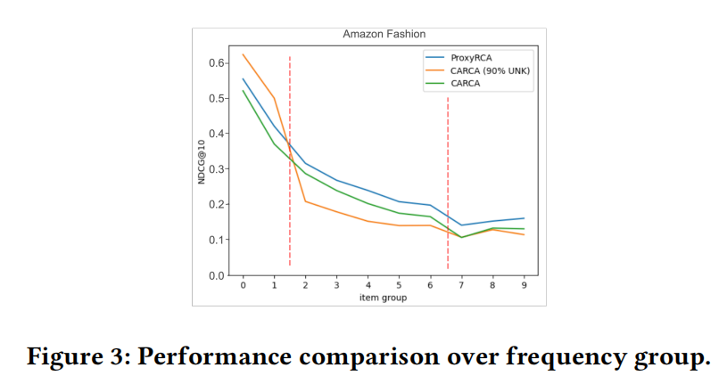
ATAI
AdvancedTechniqueof
Artificial Intelligence
ATAI
ChongqingUniversity _{AdvancedTechniqueof}
of Technology Artificial Intelligence
ChongqingUniversity of Technology
Experiments

Slide 10
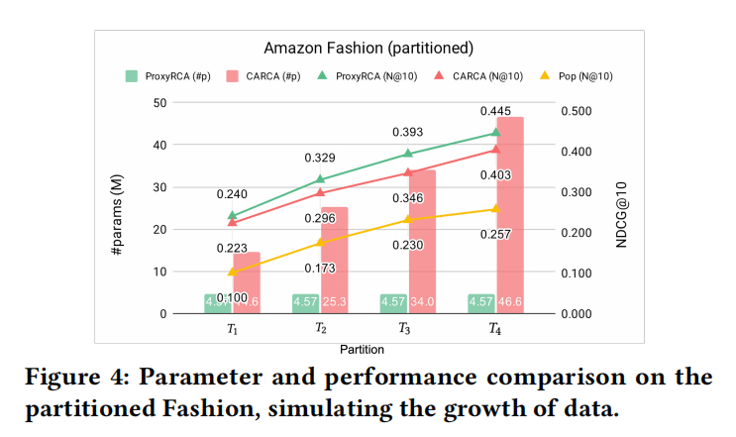
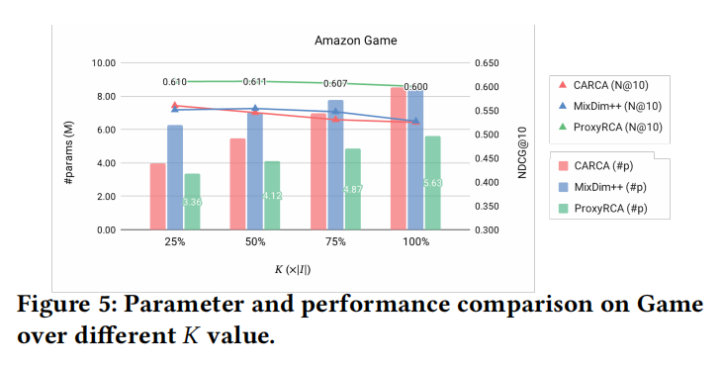
ATAI
AdvancedTechniqueof
Artificial Intelligence
ATAI
ChongqingUniversity _{AdvancedTechniqueof}
of Technology Artificial Intelligence
ChongqingUniversity of Technology
Experiments

Slide 11
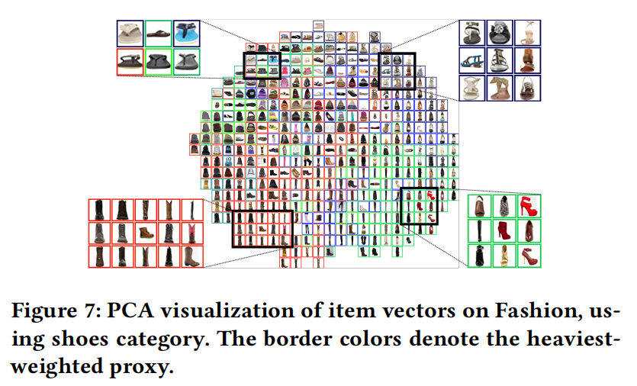
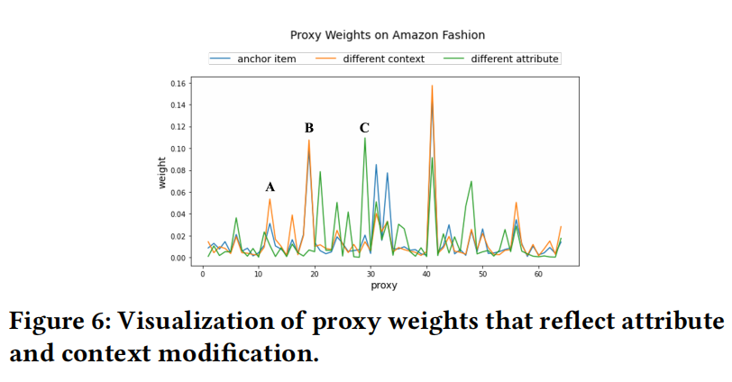
ATAI
AdvancedTechniqueof
Artificial Intelligence
ATAI
ChongqingUniversity _{AdvancedTechniqueof}
of Technology Artificial Intelligence
ChongqingUniversity of Technology
Experiments

Slide 12
ChongqingUniversity of Technology
ATAI
AdvancedTechniqueof
Artificial Intelligence
ATAI
ChongqingUniversity _{AdvancedTechniqueof}
of Technology Artificial Intelligence
Thanks!

